Slide 1
Customer Segmentation Analysis
Notes:
In this presentation, we will explore customer segmentation for a group of mall shoppers.

Slide 2
Customer Segmentation Analysis - Identifying Target Groups for Marketing Campaigns
This project analyzes a dataset of mall customers to identify potential target groups for marketing campaigns.
We will leverage KMeans unsupervised machine learning to perform customer segmentation.
The analysis will include univariate, bivariate, and multivariate clustering approaches.
Notes:
In this presentation, we will explore customer segmentation for a group of mall shoppers. We will use KMeans clustering to identify distinct customer groups based on their spending habits and demographics. By understanding these segments, we can develop targeted marketing campaigns to reach the most relevant customers.

Slide 3
Project Goals**
Understand the target customers for the marketing team.
Identify the most important shopping groups based on income, age, and spending score.
Determine the ideal number of customer groups with clear labels for marketing purposes.
Notes:
The primary goal of this project is to support the marketing team by identifying key customer segments. By analyzing income, age, and spending behavior, we will aim to uncover distinct groups with unique characteristics. These insights will allow the marketing team to tailor campaigns to resonate with specific customer segments, maximizing campaign effectiveness.

Slide 4
Market Segmentation Approach
Perform Exploratory Data Analysis (EDA) to understand the data distribution and relationships between variables.
Use KMeans Clustering to group customers into distinct segments based on their characteristics.
Analyze summary statistics for each identified cluster to gain insights into their spending habits and demographics.
Visualize the clusters to understand the separation between customer groups..

Slide 5
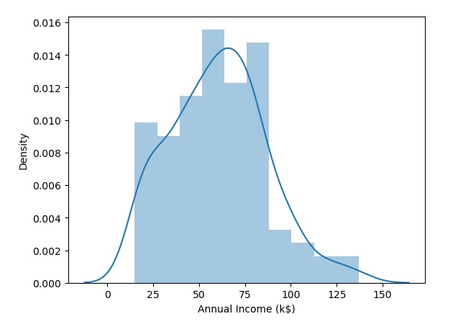
Exploratory Data Analysis - Income Distribution
Histogram depicting the distribution of Annual Income (k$).

Slide 6
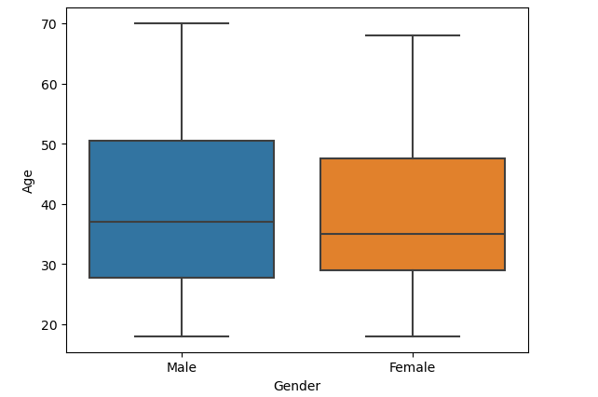
Exploratory Data Analysis - Age Distribution by Gender
Boxplot showing the distribution of Age for both genders (Female and Male).

Slide 7
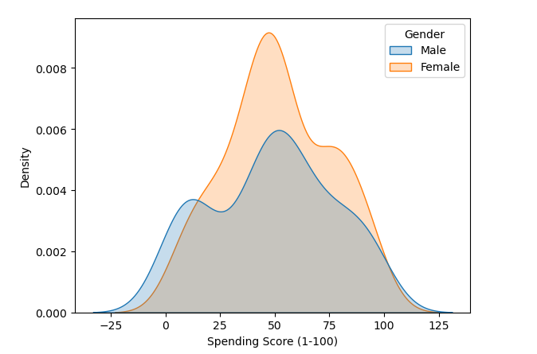
Exploratory Data Analysis - Spending Score Distribution by Gender
Kernel density plot showing the distribution of Spending Score for both genders (Female and Male).

Slide 8
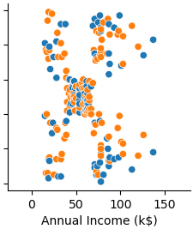


Bivariate Analysis - Income vs Spending Score
Scatter plot with Annual Income (k$) on the X-axis and Spending Score (1-100) on the Y-axis, colored by Gender

Slide 9
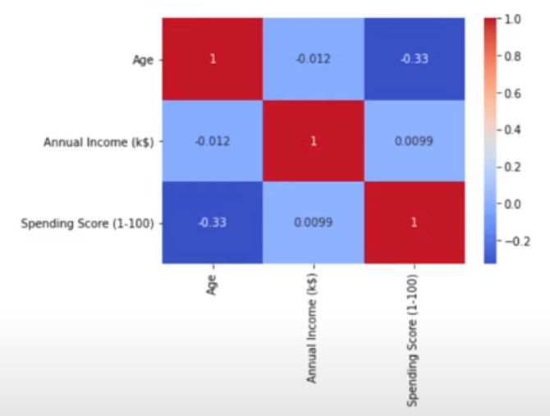
Bivariate Analysis - Correlation Matrix
Heatmap representing the correlation matrix between Age, Annual Income (k$), and Spending Score (1-100).

Slide 10
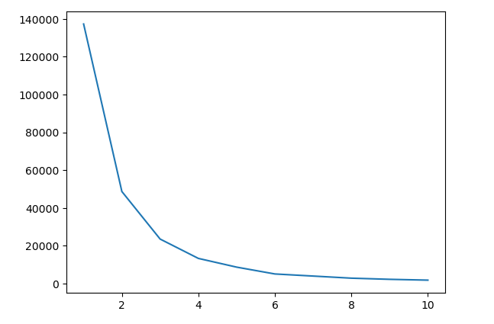
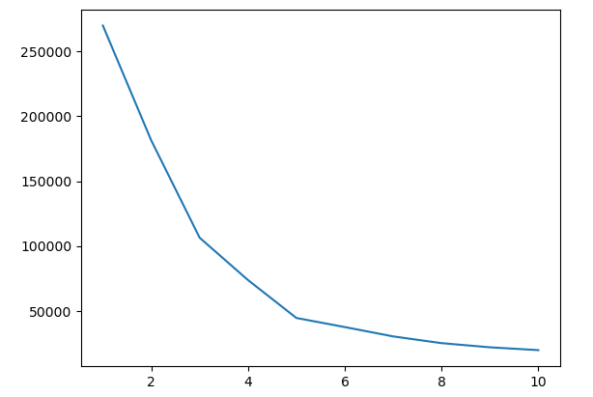
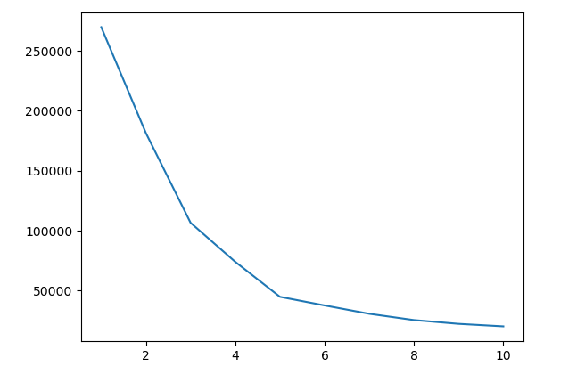
KMeans Clustering - Determining Optimal Number of Clusters
Univariate Clustering - Segment customers based on income.
Bivariate Clustering - Segment customers based on income and spending score.
Multivariate Clustering - Segment customers based on income, age, spending score, and gender (after encoding).
Elbow Method - Univariate Clustering
Elbow Method - Bivariate Clustering
Elbow Method - Multivariate Clustering
Notes:
We employ KMeans clustering to segment the customers. We start with univariate clustering using income as the sole

Slide 11
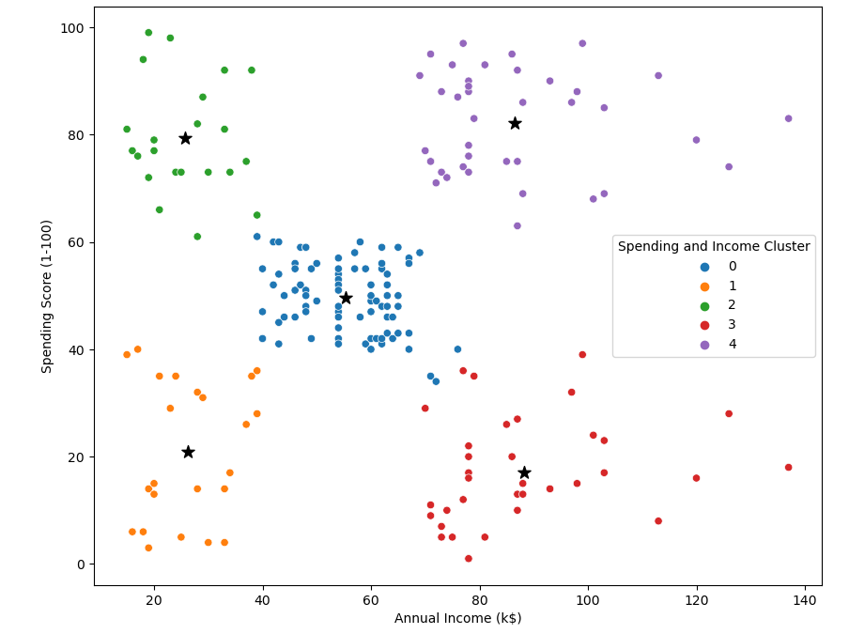
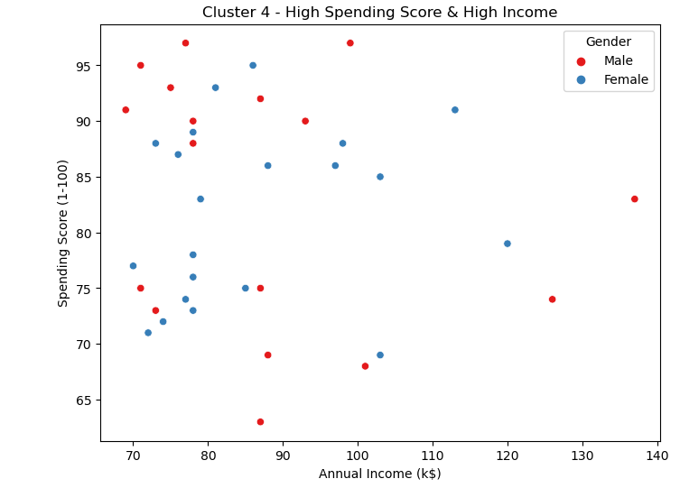
Target Cluster
A scatter plot showing Cluster 4 with high Spending Score and high Income.
Notes:
Based on the clustering analysis, Cluster 4 emerges as the most promising target group. This cluster represents customers with a high spending score and high income, indicating a strong propensity to spend. Notably, 60% of this cluster are female shoppers. This information is valuable for the marketing team, suggesting strategies to attract these high-value customers through campaigns targeting popular items within this cluster.

Slide 12
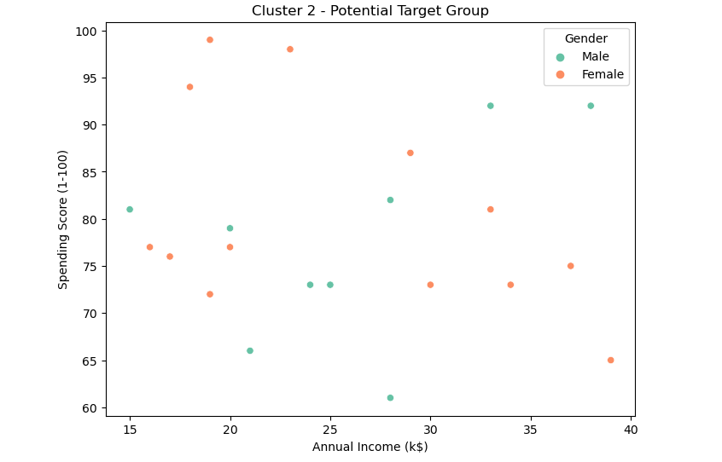
Additional Opportunities
Cluster 2 presents an opportunity to target customers with sales events on popular items
Notes:
While Cluster 4 represents high-spending customers, Cluster 2 also presents an interesting opportunity. This cluster might be receptive to special promotions and sales events. By understanding the items popular within this cluster, the marketing team can develop targeted campaigns to incentivize purchases.

Slide 13
Conclusion
KMeans clustering successfully segmented customers into distinct groups based on their income, age, and spending score.
Cluster 4 represents customers with high spending potential, and Cluster 2 presents an opportunity for targeted promotions.
These insights can be leveraged by the marketing team to develop effective customer segmentation strategies.

